Slide 1
PERSONALITY
CLASS XII
CHAPTER TWO
AKANKSHA MALHOTRA

Slide 2
WHAT DO YOU UNDERSTAND FROM THIS PICTURE ?

Slide 3
PERSONALITY
Personality has derived from a Latin word “persona’’
It refers to our characteristic way of responding to individuals and situations.
Consistency in behaviour, thoughts, and emotion of an individual across different situations and time periods characterises his or her personality.
Words related to personality-
Temperament, trait ,disposition , character ,
habits ,values etc.

Slide 4
Has both physical and psychological components.
Behaviour is unique and do not change with time.
It is dynamic in nature due to change in internal and external factors.

Slide 5
Types of personality approach
There are two types of approaches related to personality :
i) TYPE APPROACH
it attempts to comprehend personality by examining certain broad patterns in observed behavioural characteristics of individual.
ii) TRAIT APPROACH
It focuses on specific psychological attributes along which individuals tend to differ in consistent and stable way.

Slide 6
APPROACHES
TYPE
Hippocrates
Charak samhita
Trigunas
Sheldon
Carl Jung
Friedman and Rosenman
TRAIT
Allport’s trait theory
Cattell : personality factor
Eysenck’s theory
Big five factor

Slide 7
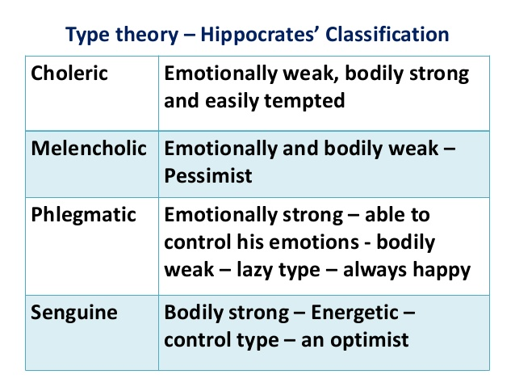

Slide 8
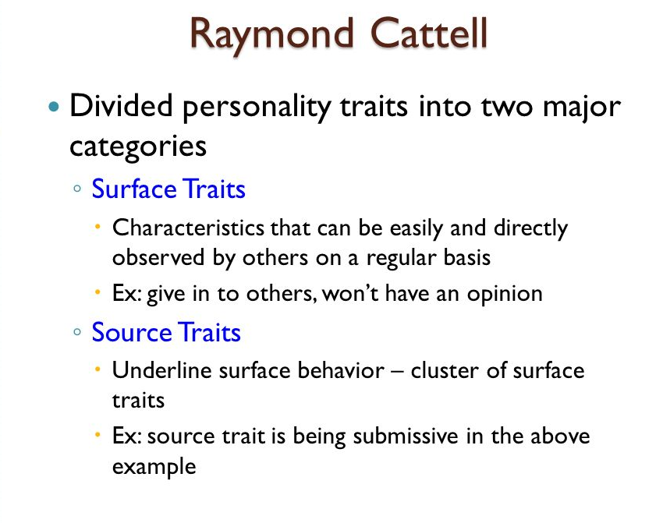

Slide 9
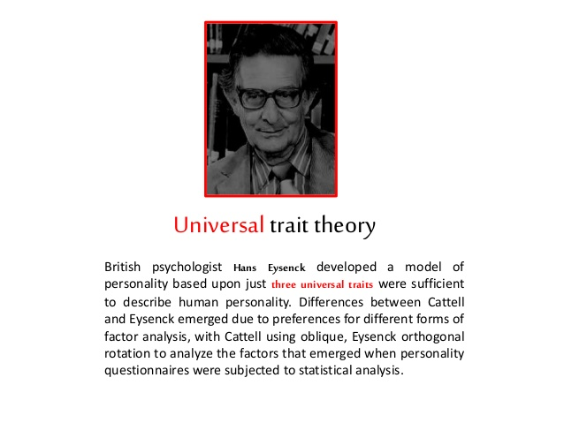

Slide 10
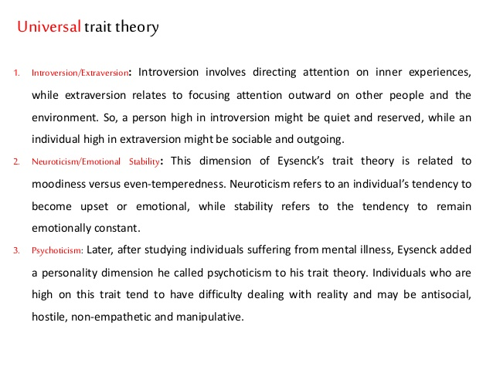

Slide 11
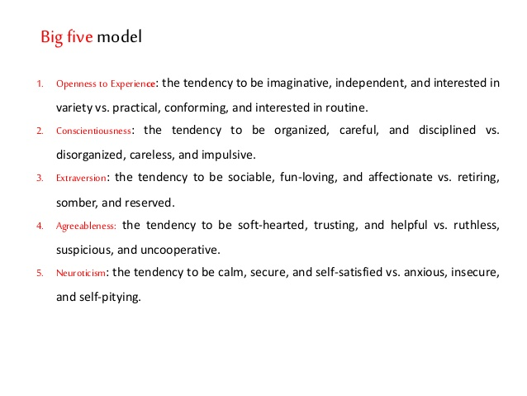

Slide 12
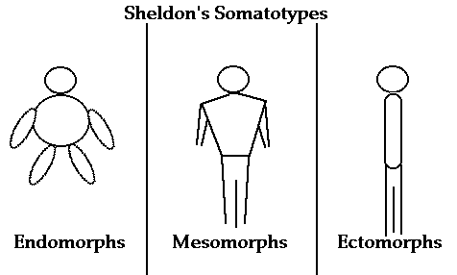

Slide 13
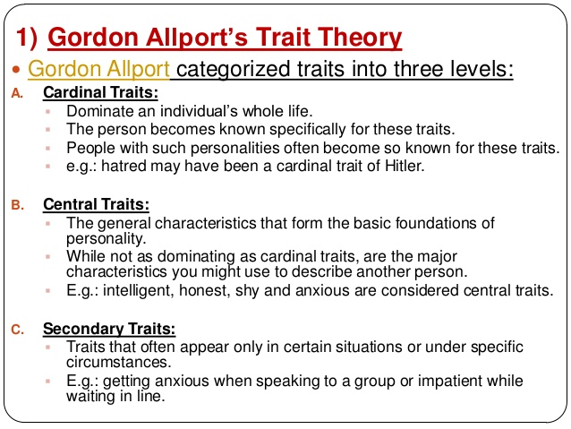

Slide 14
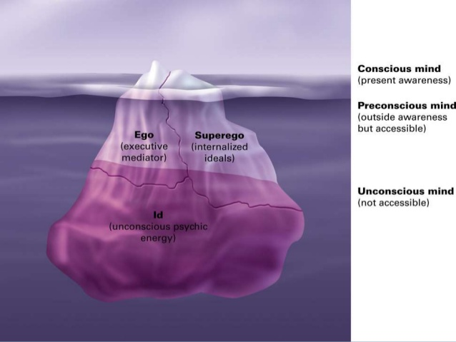
LEVEL OF CONSCIOUSNESS

Slide 15
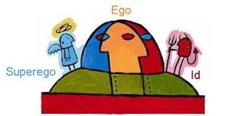

Slide 16
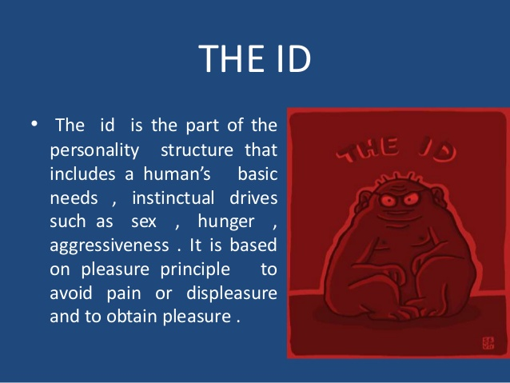

Slide 17
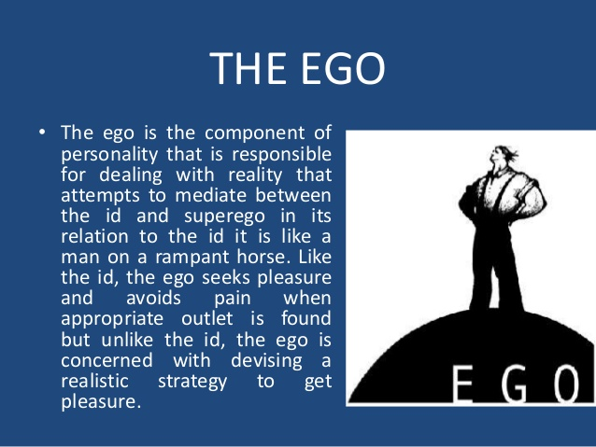

Slide 18


Slide 19
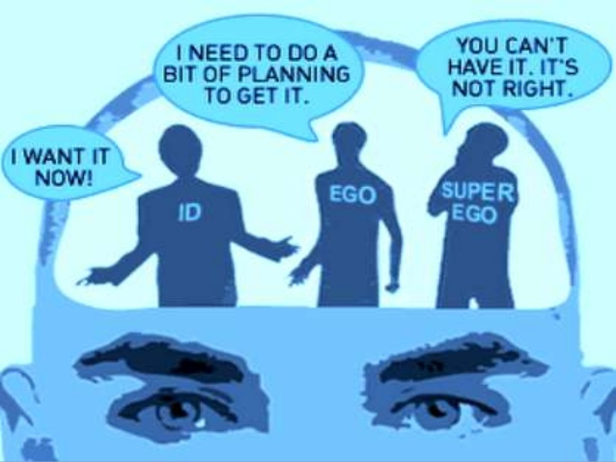

Slide 20
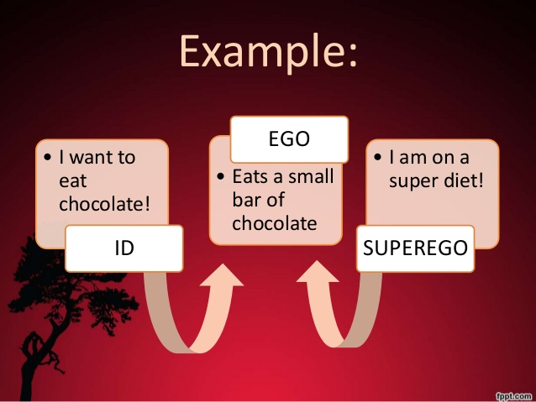

Slide 21
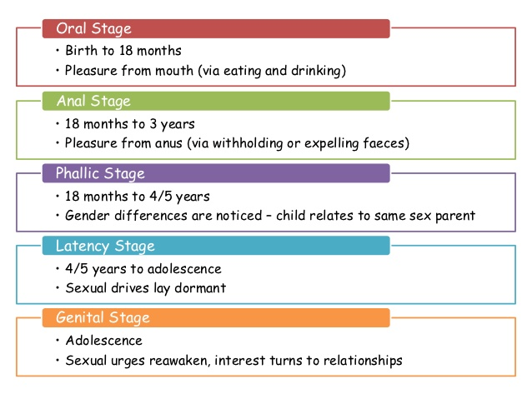

Slide 22
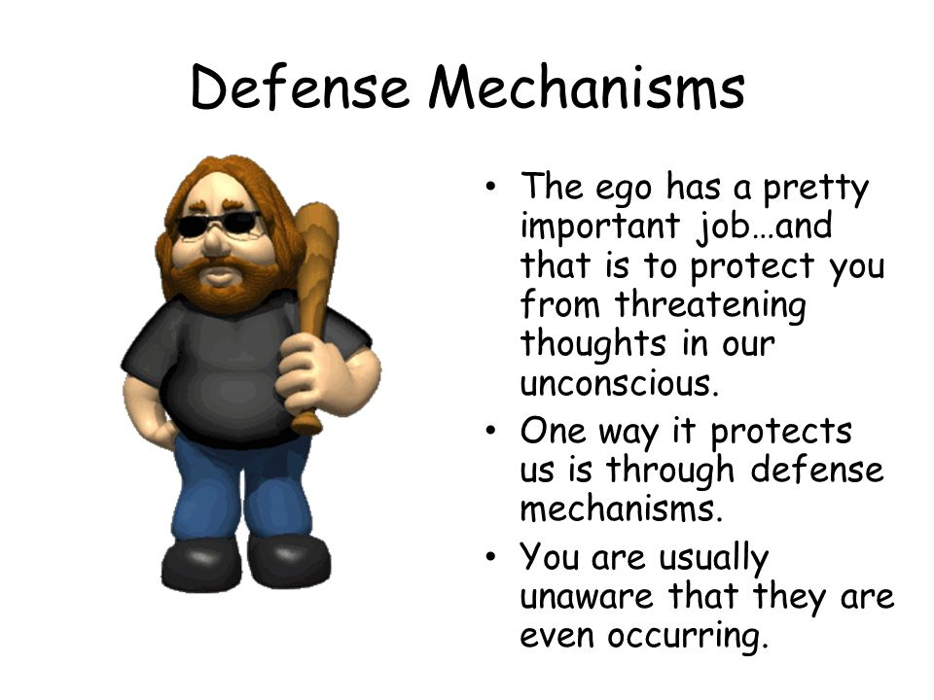

Slide 23
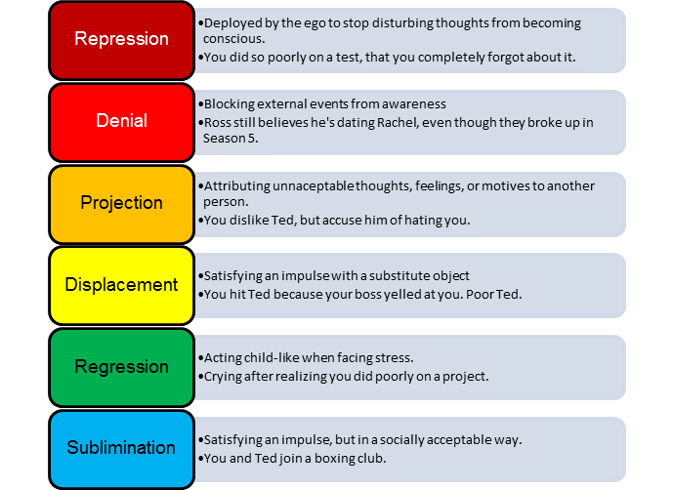

Slide 24
APPROACHES TO STUDY PERSONALITY
PSYCHODYNAMIC
BEHAVIOURAL
CULTURAL
HUMANISTIC

Slide 25
Why do we need to assess personality ?
A formal effort aimed at understanding personality of an individual.
Assessment refers to the procedures used to evaluate or differentiate people on the basis of certain characteristics .
Goal is to understand and predict behaviour with minimum error and maximum accuracy.
Try to study how an individual will behave in a given situation.
It is useful for diagnosis , training , placements , counselling .

Slide 26
TECHNIQUES USED TO ASSESS PERSONALITY
Psychometric
Self report
Projective techniques
Behavioural rating

Slide 27
SELF REPORT
The best way to assess a person is by asking him/her about himself /herself
Fairly structured and based on theory.
The responses of the subjects are rated and interpreted on the basis of norms
Demerits – social desirability
- acquiescence
Examples :
* MMPI (Minnesota multiphasic personality inventory )
* EPQ ( Eysenck personality questionnaire)
* 16 PF (Sixteen personality factor questionnaire)

Slide 28
PROJECTIVE TECHNIQUES
It is developed to assess unconscious motives and feelings.
Less structured.
Interpreted by experts
Not told about the purpose of assessment or scoring method
There are no correct or incorrect responses.
Each response is considered to reveal a significant aspect of personality
Scoring and interpretations are lengthy and subjective

Slide 29
PROJECTIVE TECHNIQUES
RORSCHACH INK BLOT TEST
THEMATIC APPERCEPTION TEST (TAT)
ROSENZWEIG’S PICTURE FRUSTATION STUDY
SENTENCE COMPLETION TEST
DRAW A PERSON TEST

Slide 30
BEHAVIOURAL ANALYSIS
Observation of behaviour under certain circumstances serves as the basis of behavioural analysis.
Interview , observation , behavioural rating , nomination and situation tests .

Slide 31
THANK YOU.....

